Slide 1
CSC 250: Foundations of Computer Science I
Fall 2023 - Lecture 11
Amitabha Dey
Department of Computer Science
University of North Carolina at Greensboro

Slide 2
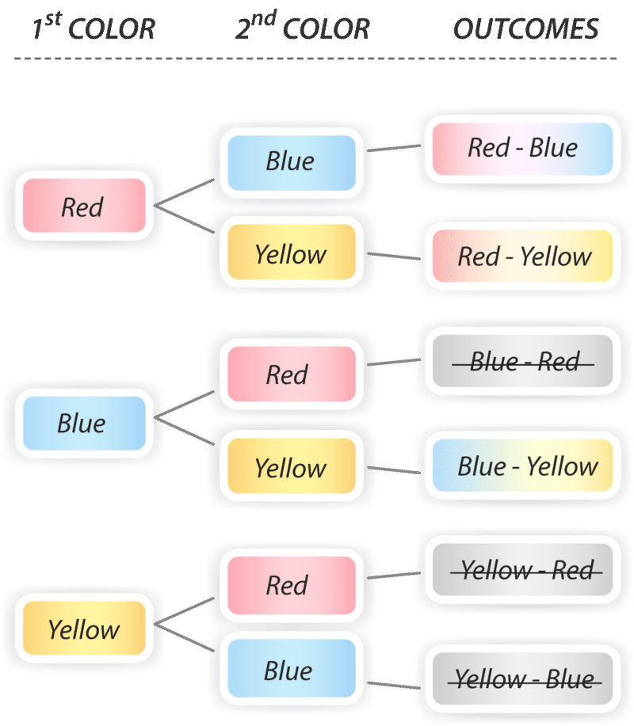
Combination
Formula Derivation
5 people: A B C D E
Choose 2 of them: 5 x 4 = 20 ways
The diagram shows all 6 permutations of the 3 colors. But we are counting combinations here, so order doesn’t matter. Therefore, in this tree diagram, we will cross out all outcomes that are repeats. For example, the first red-blue is no different from blue-red, so we’ll cross out blue-red. In all, there are 3 combinations that are not repeats.
AB | BA | CA | DA | EA
AC | BC | CB | DB | EB
AD | BD | CD | DC | EC
AE | BE | CE | DE | ED
AD and DA is counted as separated possibilities.
If we only cared about what 2 people end up with and not the order in which they were chosen, then every possible pair, we have twice in this table, because there is two possible orderings that group could have been chosen in.
So we have divide 20 by (the number of ways we could have chosen the group = 2)

Slide 3
Combination
Formula Derivation
4 people: Choose 3 of them in a group
A B C D
4 x 3 x 2 = 24
5 people: A B C D E
Choose 2 of them: 5 x 4 = 20 ways
AB | BA | CA | DA | EA
AC | BC | CB | DB | EB
AD | BD | CD | DC | EC
AE | BE | CE | DE | ED
ABC | BAC | CAB | DAB
ABD | BAD | CAD | DAC
ACB | BCA | CBA | DBA
ACD | BCD | CBD | DBC
ADB | BDA | CDA | DCA
ADC | BDC | CDB | DCB
AD and DA is counted as separated possibilities.
If we only cared about what 2 people end up with and not the order in which they were chosen, then every possible pair, we have twice in this table, because there is two possible orderings that group could have been chosen in.
So we have divide 20 by (the number of ways we could have chosen the group = 2)
There are 6 different ways of choosing the same 3 people.
In other words, there are 6 ways (3!) of ordering 3 things.
nCr = nPr / r! (order doesn’t matter)

Slide 4
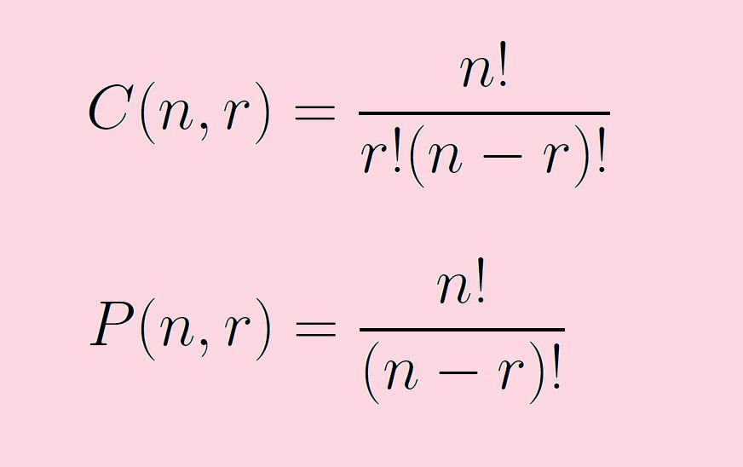
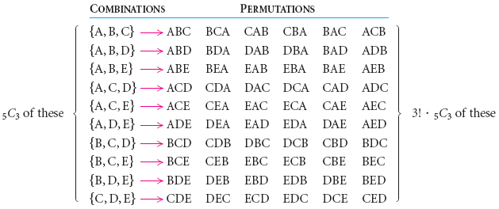
Combination
A combination is a selection of items from a set that has distinct members, such that the order of selection does not matter
Image credit - https://www.math10.com/
Image credit - https://www.thoughtco.com/

Slide 5

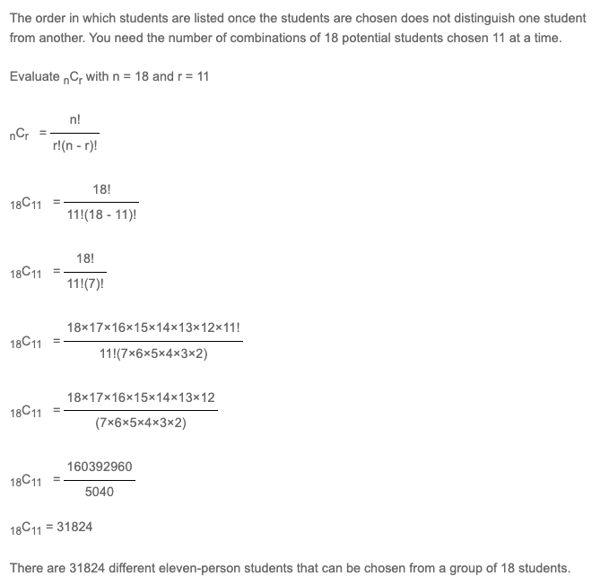
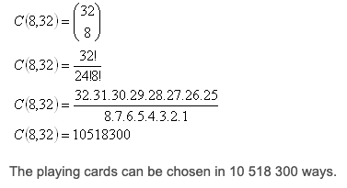

Combination
Examples
Image credit - https://www.priklady.eu/
Marcos is handing out Frisbees to his teammates
He is handing them out 2 at a time and there are three colors: yellow, red, and blue. How many color combinations are possible?
Image credit - https://www.basic-mathematics.com/

Slide 6


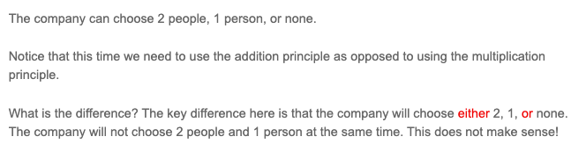
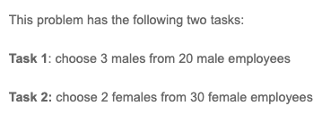


Combination
Examples
Multiplication Principle
Addition Principle
Image credit - https://www.basic-mathematics.com/

Slide 7
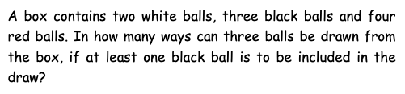

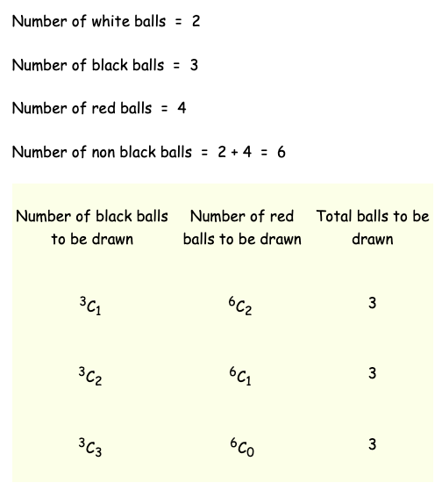
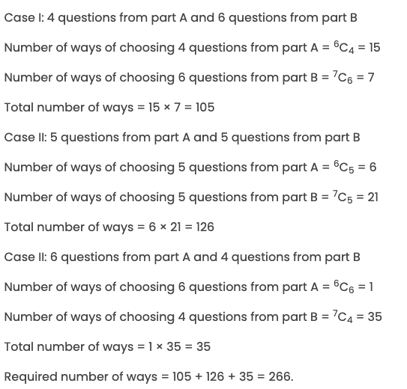
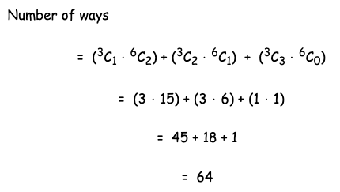
Combination
Examples
Image credit - https://byjus.com/
Image credit - https://www.onlinemath4all.com/

Slide 8
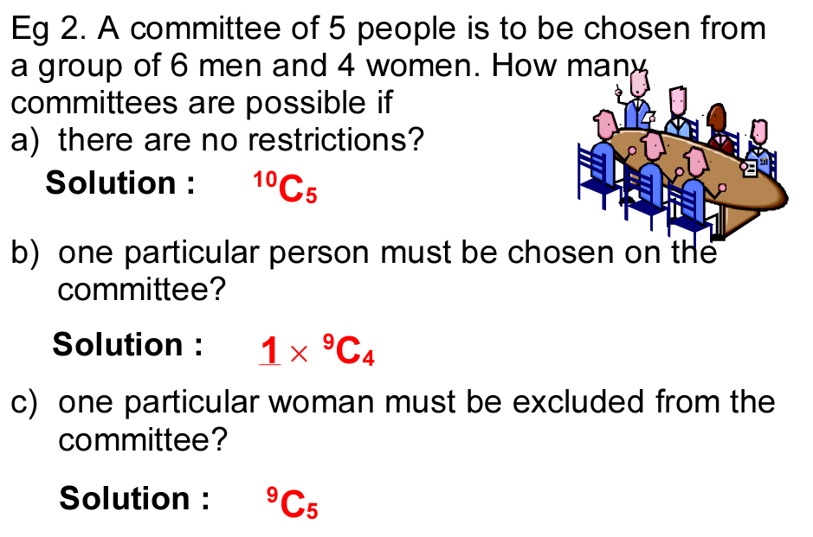
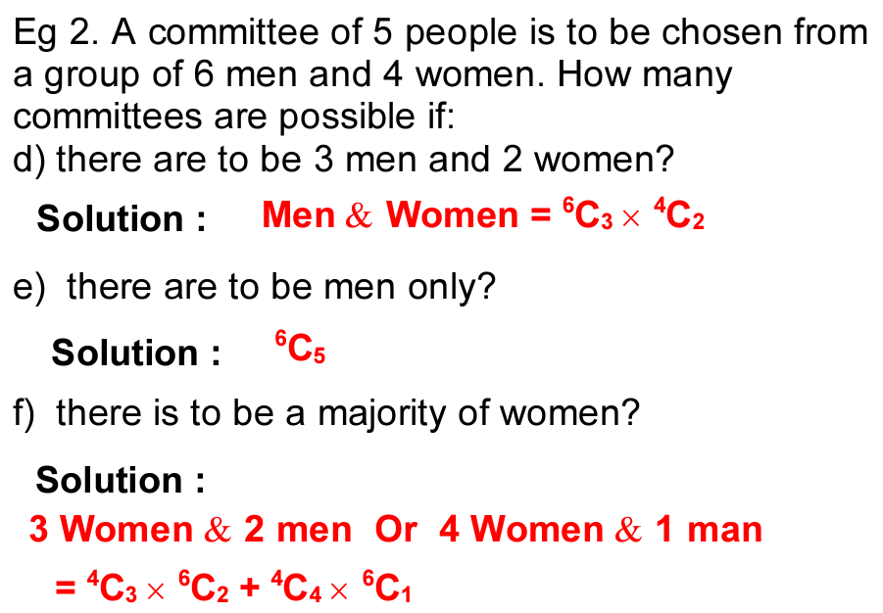
Combination
Examples
Image credit - University of Wollongong Australia

Slide 9
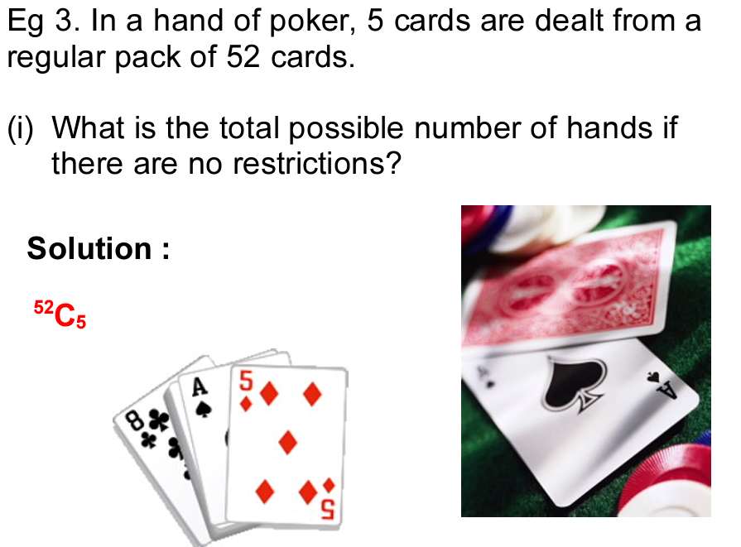
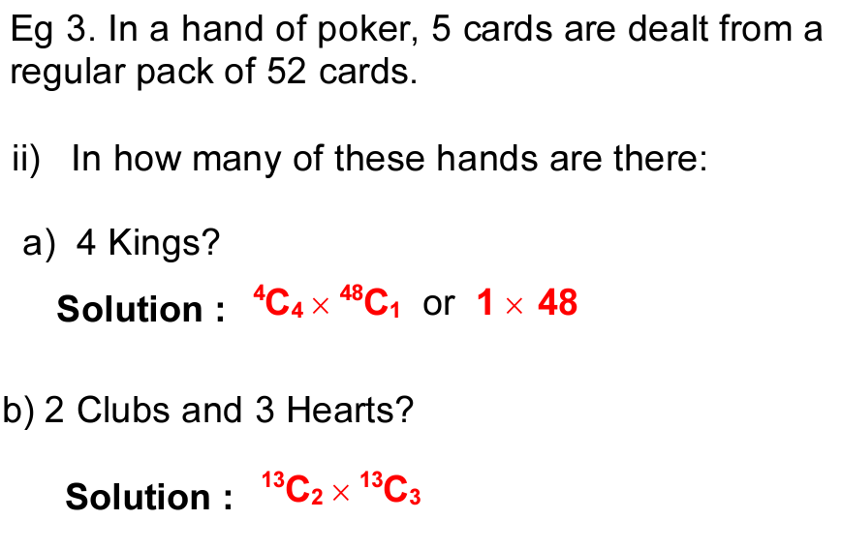
Combination
Examples
Image credit - University of Wollongong Australia

Slide 10
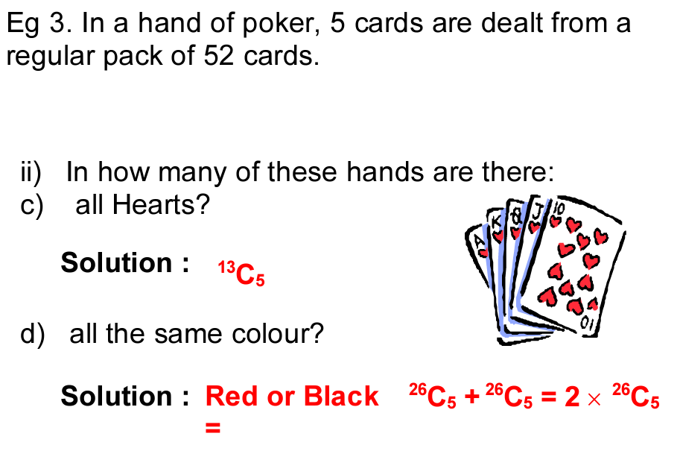
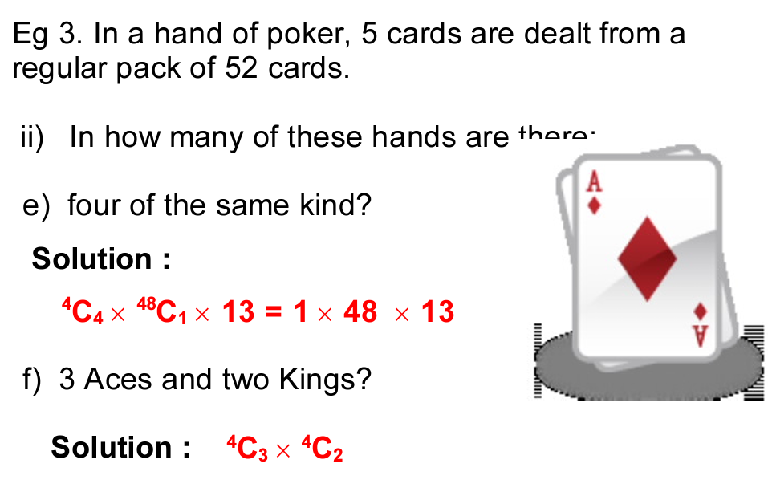
Combination
Examples
Image credit - University of Wollongong Australia

